Slide 1
Analyzing Amazon Reviews
NLP Approach

Slide 2

Objective
train an NLP algorithm to recognize positive vs negative reviews of diverse items.
Data Source: Amazon Reviews of selected items.
Possible use cases: Identify sentiment of product from various social media websites.

Slide 3
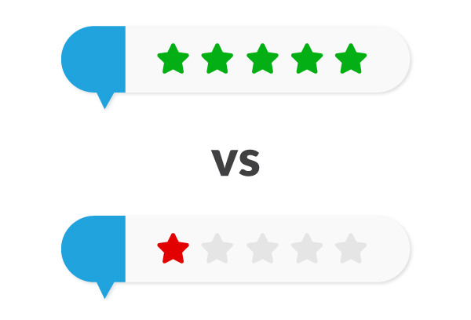
DataSet
3760 individual reviews.
Included the date, country of origin, title of review, full coment, and rating given.
Rating: [1-3] -> negative sentiment. [4-5] -> positive sentiment

Slide 4
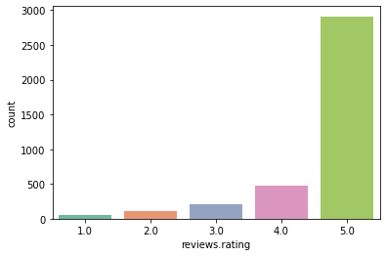
Distributions of Ratings
Notes:
Total Visits Online is slightly skewed to the right.
Total Visits Bank seems to have a hard limit at 5, perhaps further visits are not recorded?

Slide 5
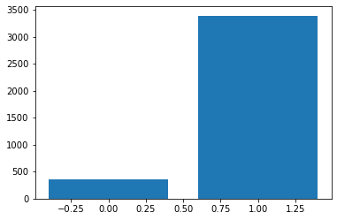
Distribution of Target Variable

Slide 6
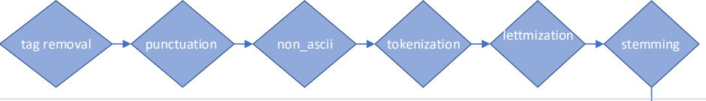
Data Preprocessing

Slide 7
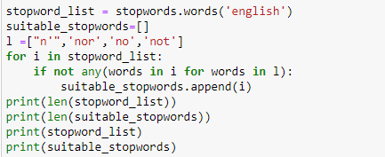
Removal of (non-negative) Stopwords
3 or 4 clusters can be easily identified.

Slide 8
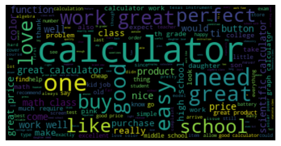
Wordcloud of Positive Reviews
Conventionally positive adjectives and verbs such as: ‘great’,’perfect’, ‘love’, ‘like’, etc.

Slide 9
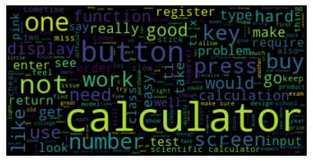
Wordcloud of Negative Reviews
Specific calculator parts and functions (‘button’, ‘press’, ‘number’, etc.)

Slide 10
Model: LinearSVC
Class | Precision | Recall | f1-score | support
0 (Negative) | 0.66 | 0.45 | 0.53 | 69
1 (Positive) | 0.95 | 0.98 | 0.96 | 689
Total Accuracy: 0.988

Slide 11
Conclusions
The model can successfully differentiate between negative and positive comments for a given product.
Next steps: deploy it for use with different products, test with different data sources (twitter, facebook, etc.)

Slide 12
Appendix

Slide 13
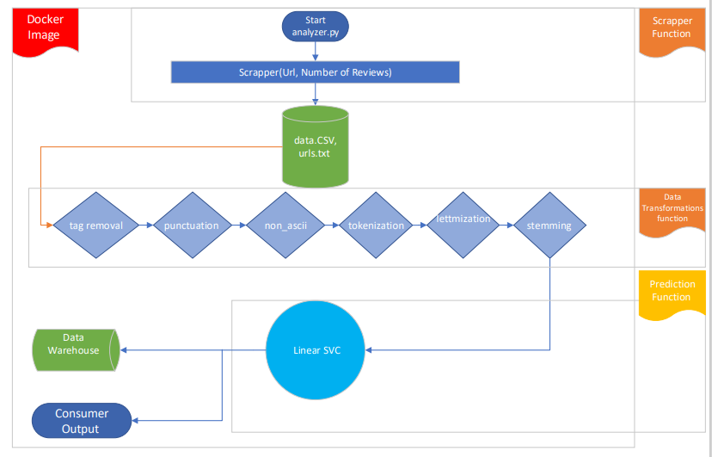
Dockerization Architecture

